Slide 1

Weather Dashboard
By Team React (Seema, Charlotte, Ahmed and Mohamed

Slide 2

Elevator Pitch
To create a real-world front-end application that we can showcase to future employees. This weather dashboard is an interactive web-page that allows users to search location of choice and preview up to 5 days weather forecast. Features such as saving data and viewing location on map are just two of the many features included on this webpage using clean user interface and java-script.
Seema

Slide 3
Concept
*insert bits of readme to help complete this*
Charlotte

Slide 4
Process
*How we split tasks, gave personal deadlines, met up out of class, had a groupchat and discussed process and helped each other during xyz issues and got along well as a team*
Ahmed

Slide 5
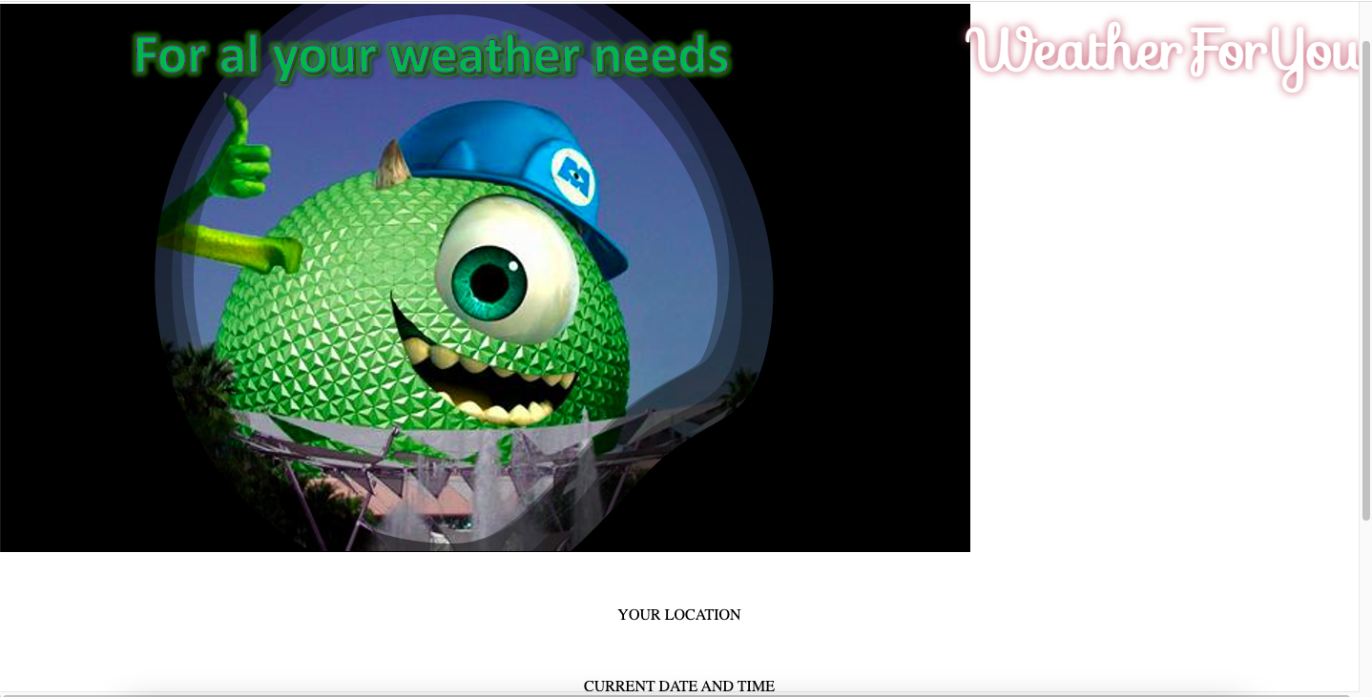
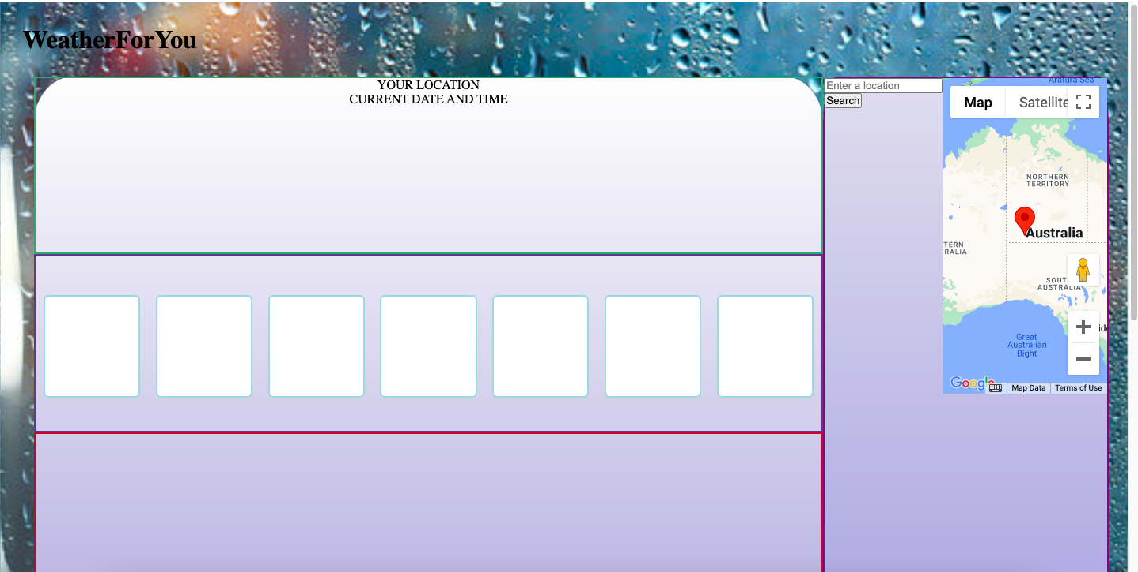
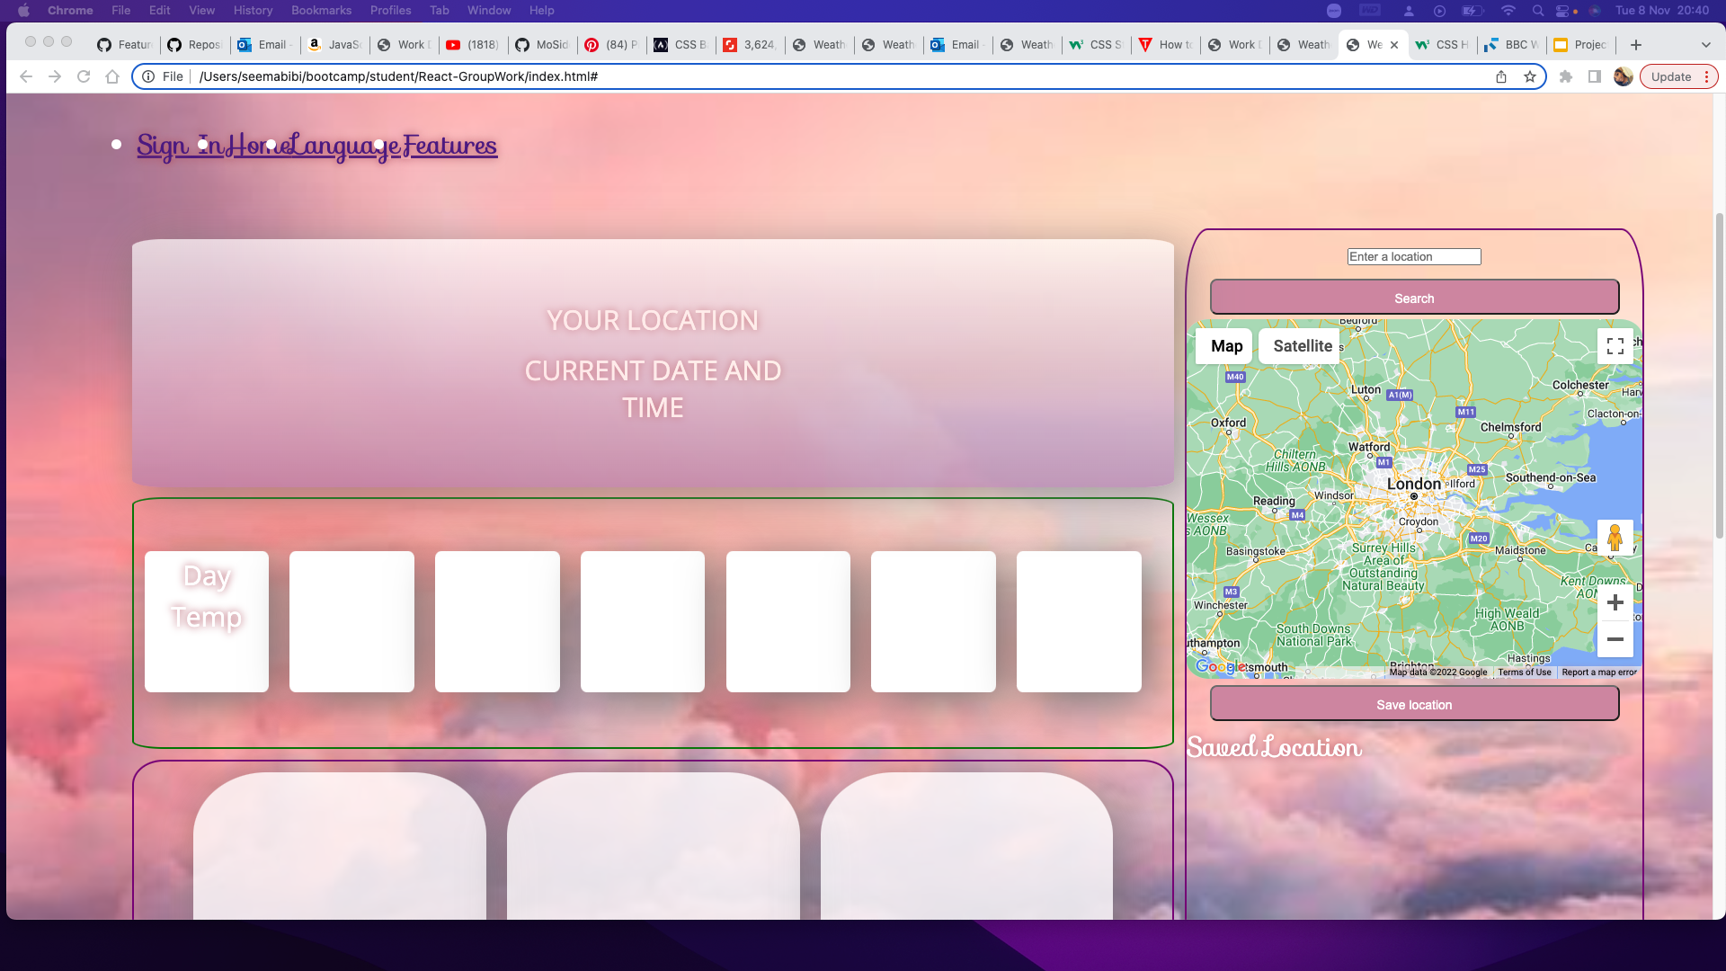
Behind the Scenes
Seema

Slide 6
Demo
*insert video on using this webpage on both laptop and phone*
Charlotte

Slide 7
Direction for Future Development
Seema: I enjoyed working as a team and bringing different creative ideas together and really enjoyed the Css elements of the project. I struggled understanding some of the JS and the work behind API’s and felt annoyed with merge conflicts.
Charlotte:
Ahmed: I Putting the skills I learned in using web APIs with JavaScript into a practical project. I struggled with Ensuring that the API's would function display the same results onto the screen as they did in the console.
Mohamed:
Mohamed

Slide 8
Links
Deployed Link:
Github Repo:
Ahmed

Slide 9

THANK YOU FOR LISTENING

